Slide 1
Part I: Raw Data Plots

Slide 2
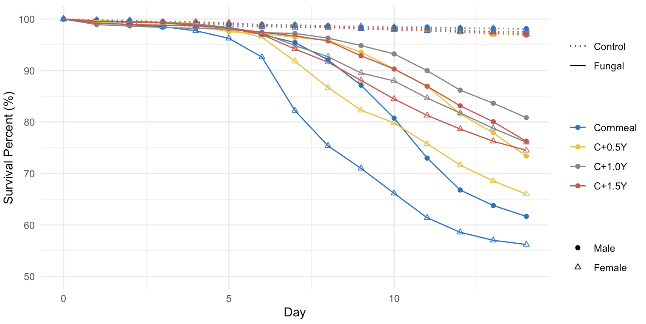

Slide 3
Part II: Cox Model

Slide 4
